Slide 1

Image Processing Exercises
Hands-on session
Naomi Thiru
KU Leuven(SADL)

Slide 2
Learning Objectives
At the end of the session participants should be able to:
Obtain data from satellite and perform a general inspection (cloud cover percentage, overlap zones etc)
Perform band composition layers for exploratory analysis
Understand land cover classification process: Raw (analysis ready) data -->Training data--> preprocessing--> ML-->Post processing

Slide 3
Main steps
Install semi auomatic classification plugin
Download satelite imagery and select most suitable ones
Create data stack for classification
Perform exploratory data analysis
Run classification
Inspect results and stylize output layers

Slide 4
Quick re-cap

Slide 5
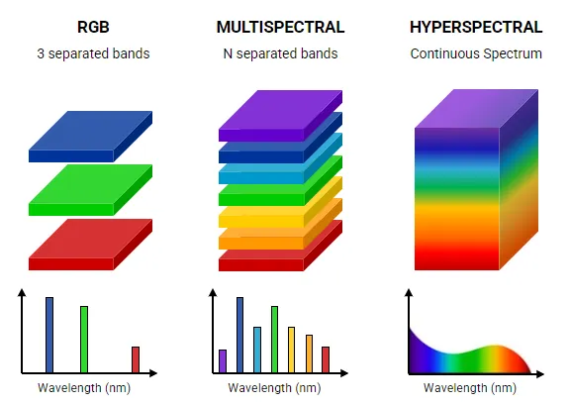
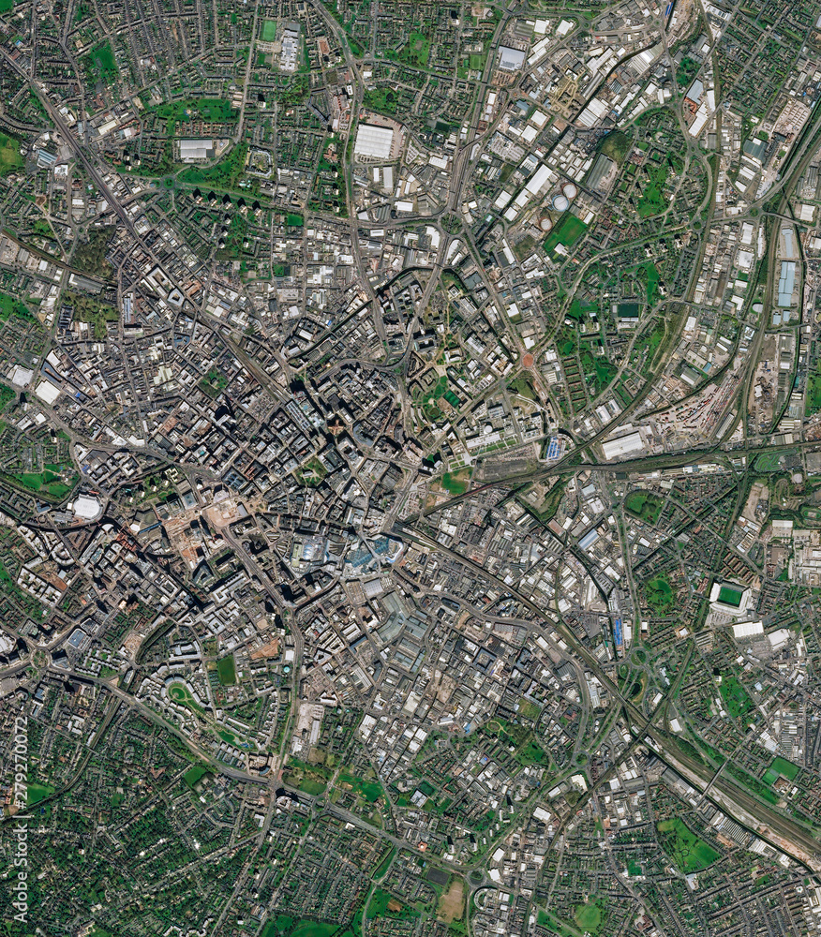
Image data

Slide 6
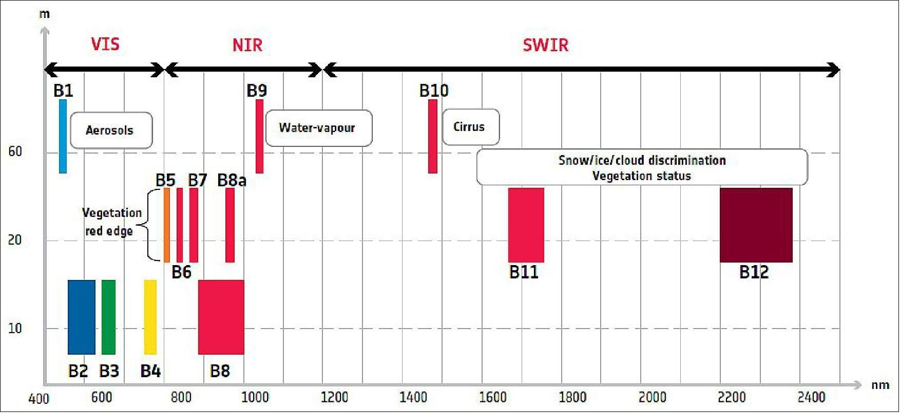
Bands across the Electromagnetic Spectrum

Slide 7
Set up QGIS project

Slide 8
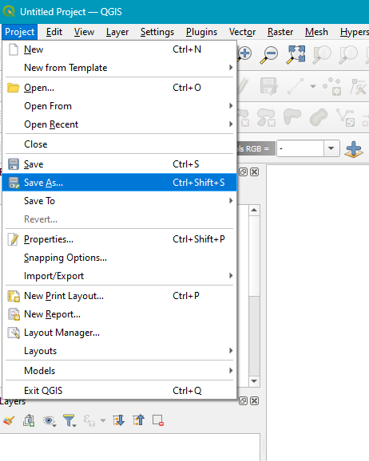
Launch QGIS and create project.
Launch your QGIS
1. Click on project and go to Save As…
2. Save a QGIS project in your project folder as classification.qgz (or a differnet name if you wish.)
1
2

Slide 9
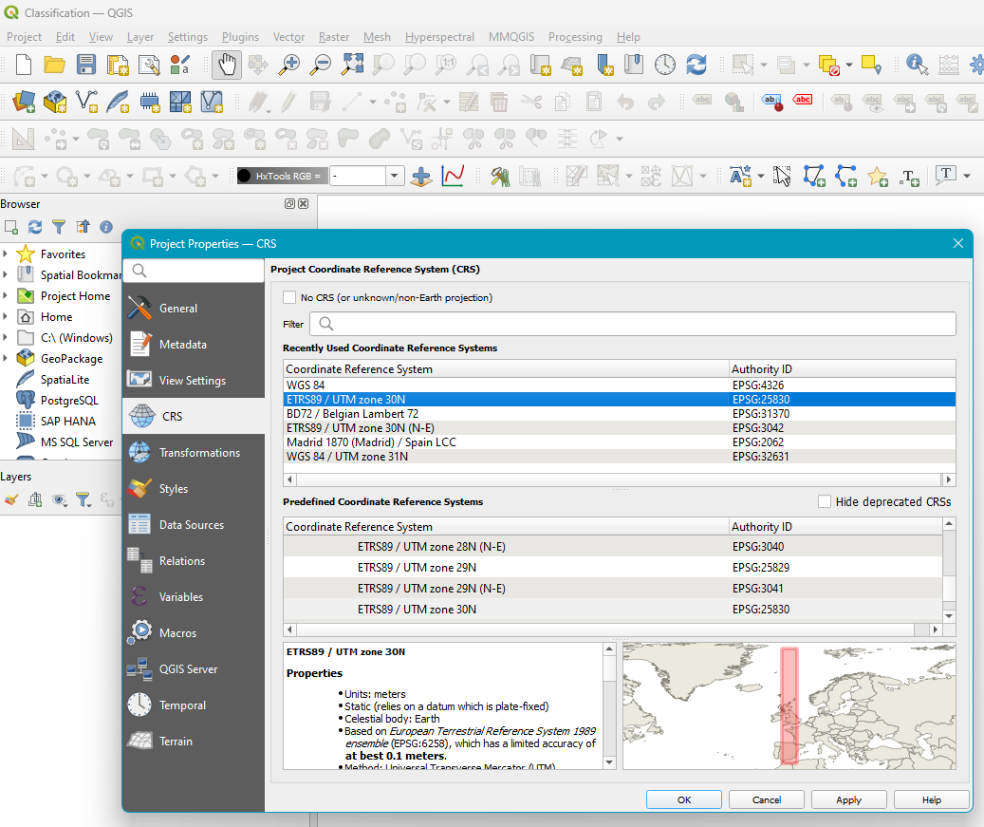
Set project crs
1
We will use EPSG:25830 as the project CRS
Click on project (top left corner) and select Properties…
Click on CRS
In the Filter box type EPSG:25830 and select it from the coordinate reference system box.
Once it is selected, click Apply
Click OK to exit.
3
2
5
4

Slide 10
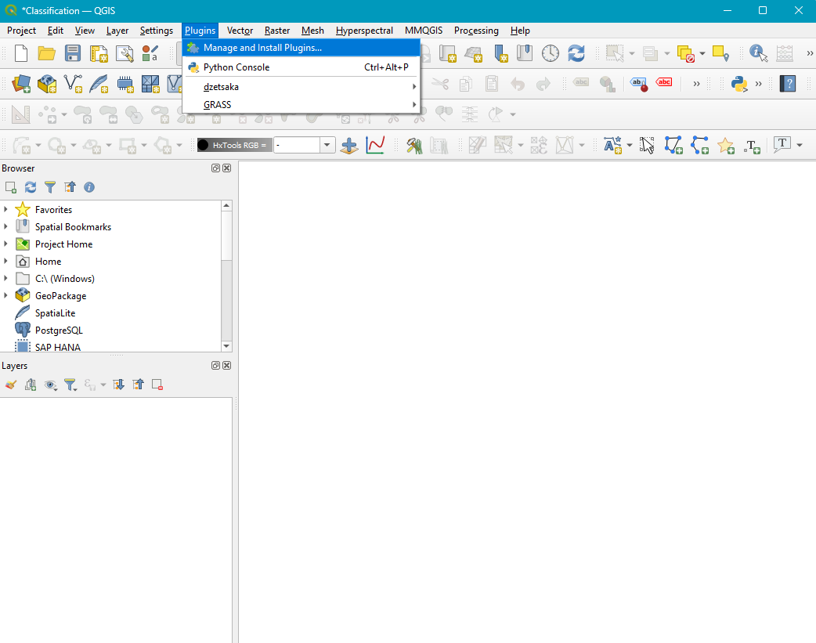
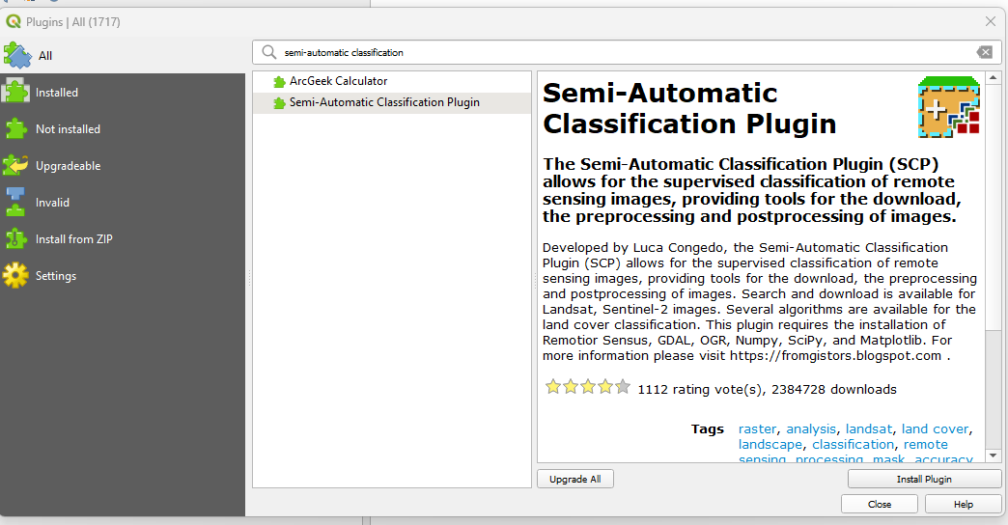
Install the necessary plugins
A QGIS plugin is a software component that extends the core functionality of QGIS by adding new features, tools, and capabilities.
We will use the semi-automatic classification plugin(SCP), and dzetsaka
Click on Plugins and select Manage and Install Plugins…
The Plugins window opens. Click on All on the left hand pane.
On the search bar, type semi-automatic classification
Click on Install Plugin
Back on the search bar, type dzetsaka, and Install plugin as well
Close the window.
1
2
3
4, 5
6

Slide 11
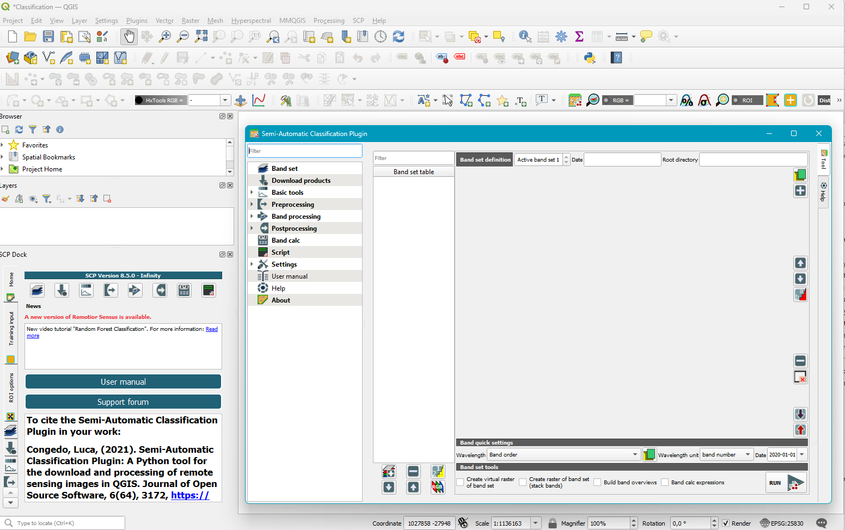
Launch SCP
Click on the SCP icon to open the plugin window(3)
You can open SCP by expanding the SCP Dock. Otherwise, close this dock for better visibility of the Layers panel
1
3
2

Slide 12
Define area of interest

Slide 13
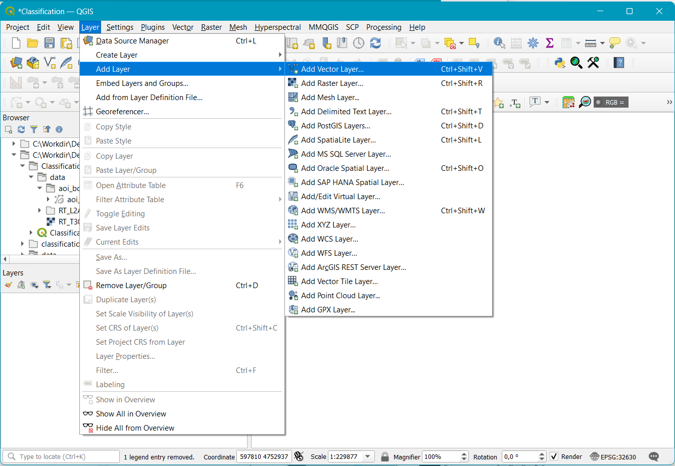
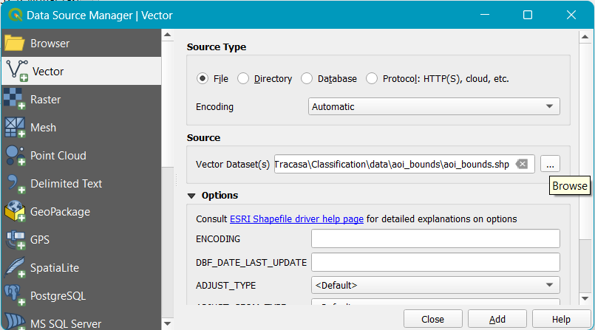
Laod area of interest (aoi) bounding box
1
Click the Layer button, and select Add layer
Select Add Vector Layer... This opens the Data Source Manager| Vector window.
On Source, click (…) on Vector Dataset(s), and navigate to your project data folder. Select aoi_bounds.shp to click open.
Click Add
Click Close to exit the window.
2
3
4
5

Slide 14
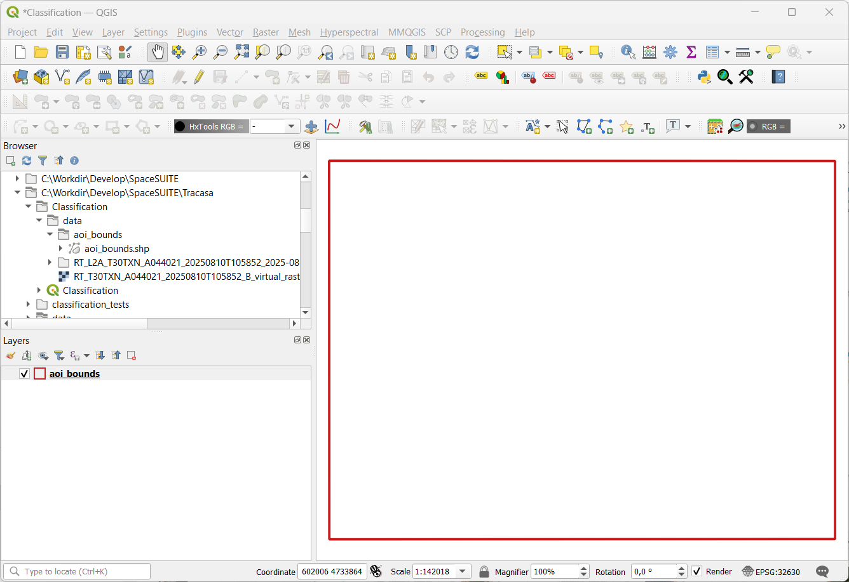
Laod area of interest (aoi) bounding box - 2
Your aoi_bounds layer should now be visible on the Layers panel.
You can also navigate to your project folder on the Browser panel, an drag and drop aoi_bounds.shp to the Layers panel.
1
2

Slide 15
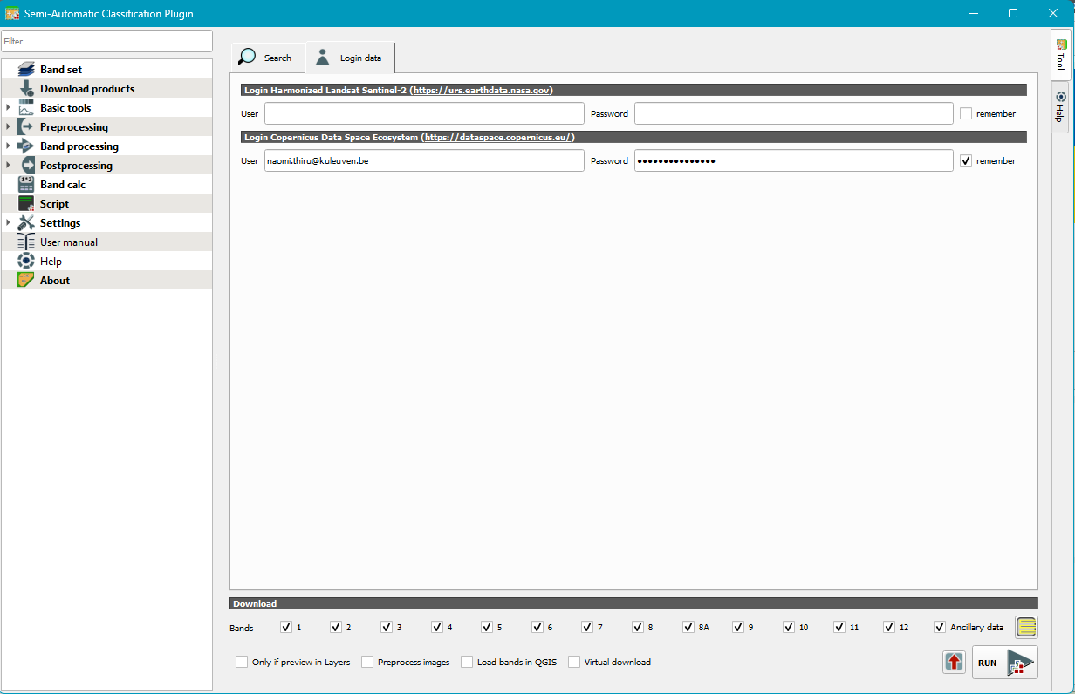
Login to the Copernicus server
Click on Download products
Select the Login data pane
In the Login Copernicus Data Space Ecosystem (https://dataspace.copernicus.eu/), put in your credentials and check remember
DO NOT CLICK ON RUN YET.
4. Go back to the Search pane
4
2
1
3

Slide 16
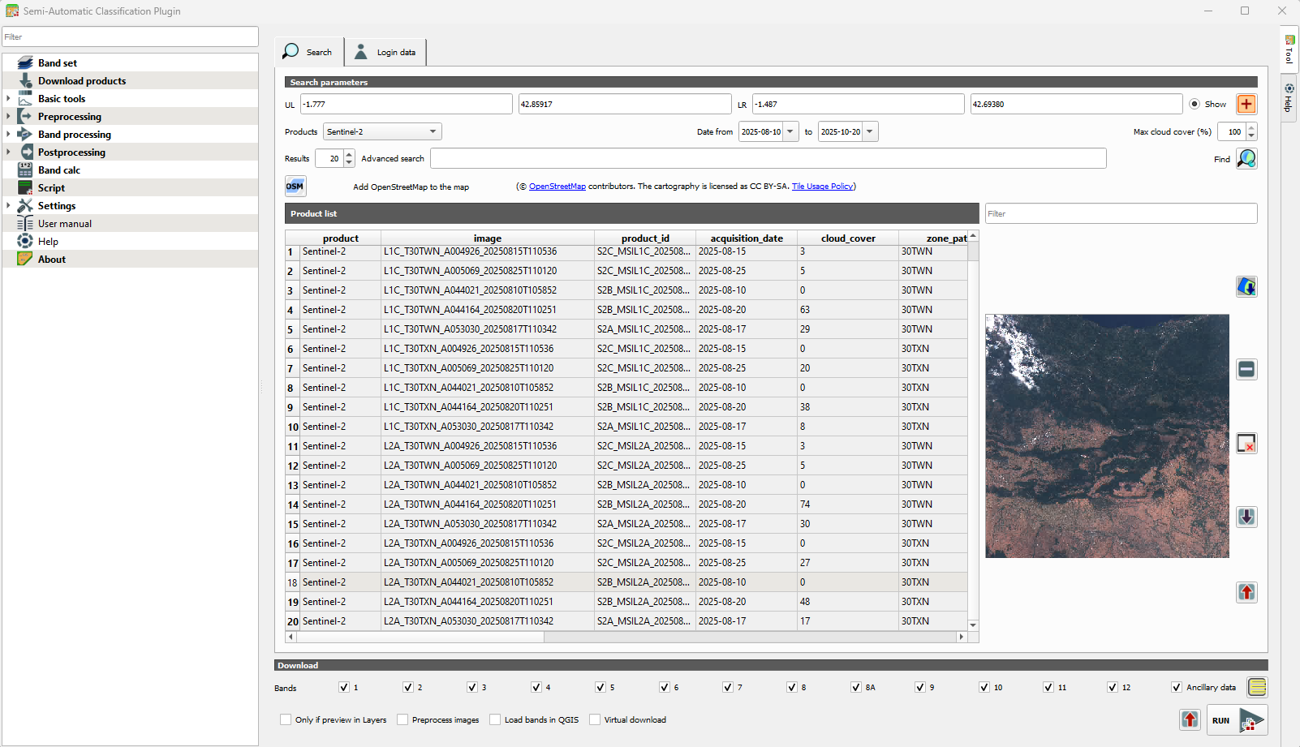
Search for data
Let’s search for some data!
1. On Search parameters, input the aoi parameters:
UL: -1.777, 42.85917
LR: -1.487, 42.69380
2. Ensure Show is selected
3. Input the dates:
Defaults to retain:
Products: Sentinel-2
Results: 20
4. On the Product list, right click on a product
5. The selected product from the Product list is displayed here
** Check especially cloud_cover properties of the images
2
1
3
4
5

Slide 17
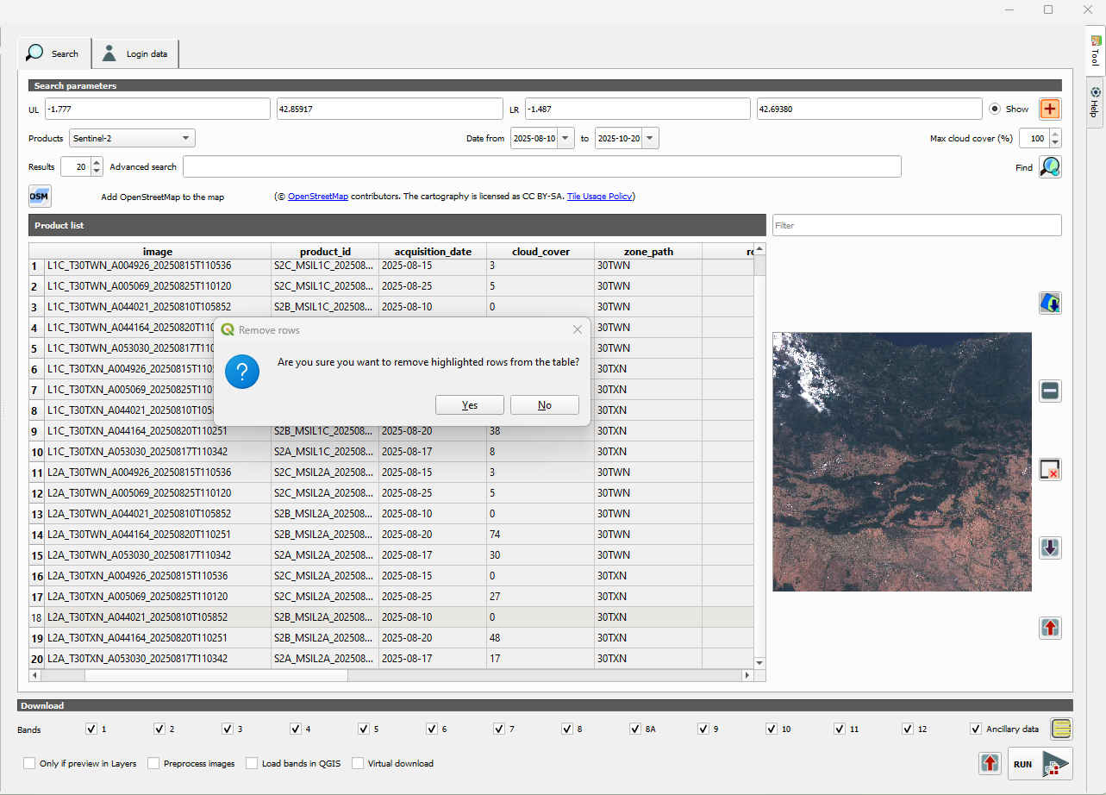
Identify dataset
Identify the ideal image to continue the rest of the exercises.
For this course we will select L2A products, and NOT L1C products
1. On the Product list, Ctrl + Right click all the layers you wish to remove to highlight them.
2. Leave only the product you wish to retain.
3. In the Remove rows pop-up window, click on Yes.
3
1
2
1

Slide 18
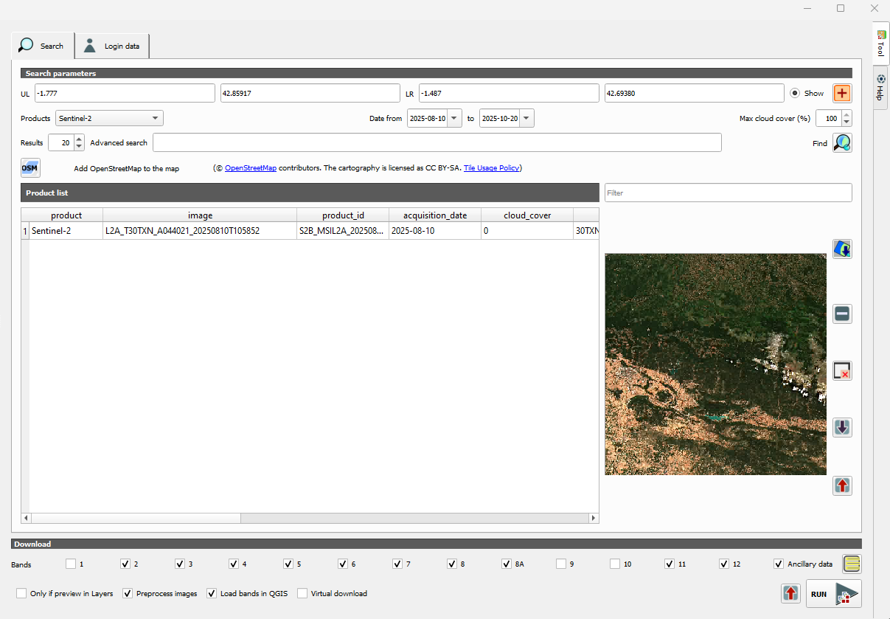
Download dataset
Download your selected data as follows:
Make sure you are satisfied with the image you selected ie minimal cloud cover.
On the Download ribbon, uncheck Bands 1, 9 and 10
This only selcts 10m and 20m resolution bands. We leave out 60m bands
Below that, check the Preprocess images box
Also, check the Load bands in QGIS box.
Now you can download by clicking RUN.
A dialogue box will open.
Select the data folder in Classification project folder to save the images there.
Confirm that your downloaded file starts with RT_.
1
2
5
3
4

Slide 19
Create bandset

Slide 20
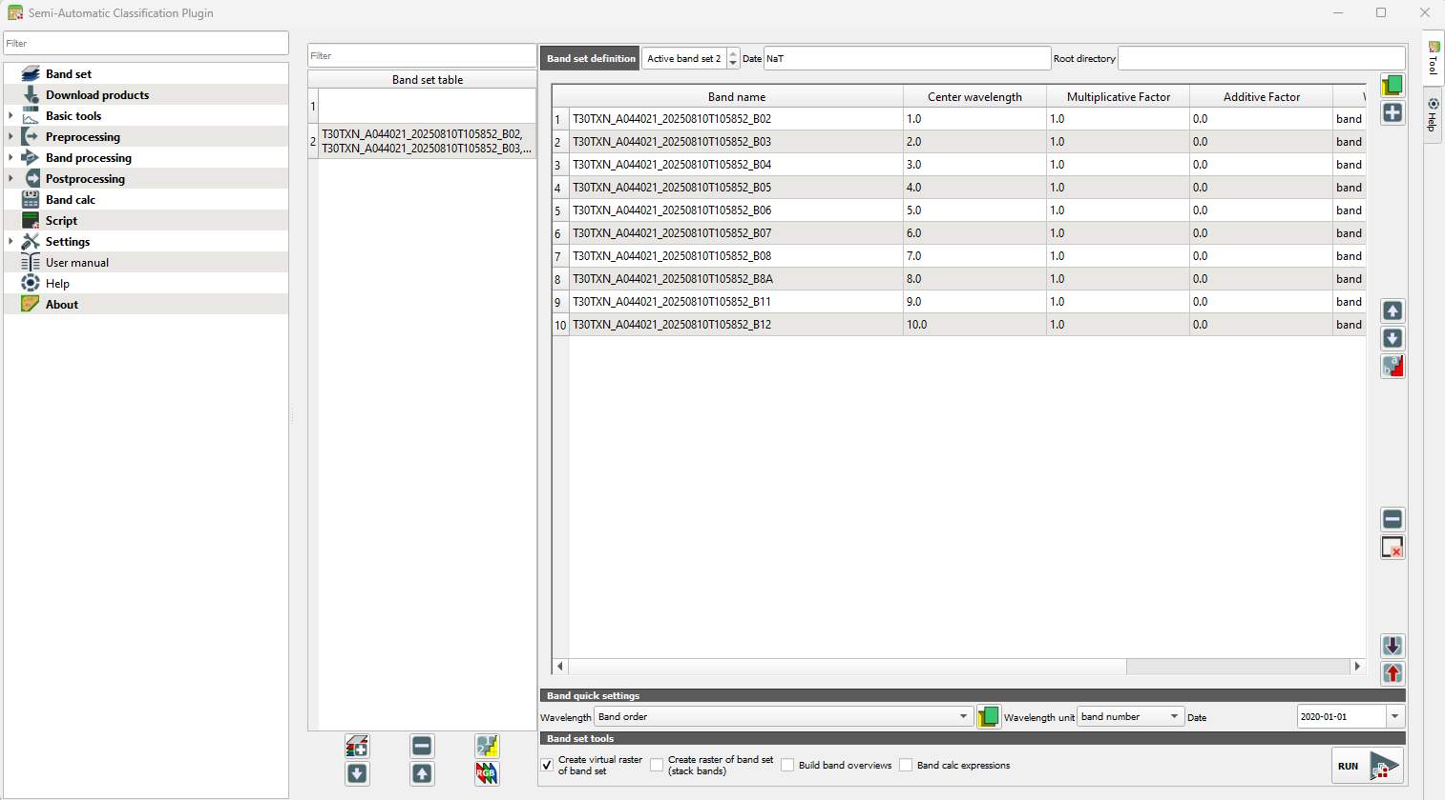
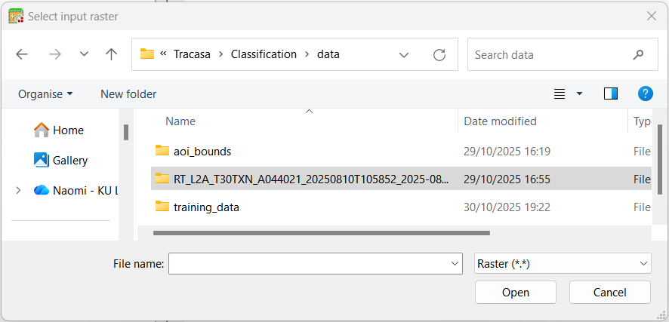
Create virtual raster
1
2
Download your selected data as follows:
On the left-hand pane, select Band set to open the window.
Click on the green icon to load your data
The Select input raster window opens up.
Click on your dataset folder and click Open.
Select all the .tiff files ( B02,B03, B04, B05, B06, B07, B08, B08A, B11, B12) (ctrl+right click) and click Open to add them to the Band set pane.
Ensure the bands are correctly ordered from B02-B12
In the Band set tools ribbon, check the Create virtual raster of band set only.
Click RUN
This will save your image as .vrt, and add it to QGIS.
6
3
4,5
7
8

Slide 21
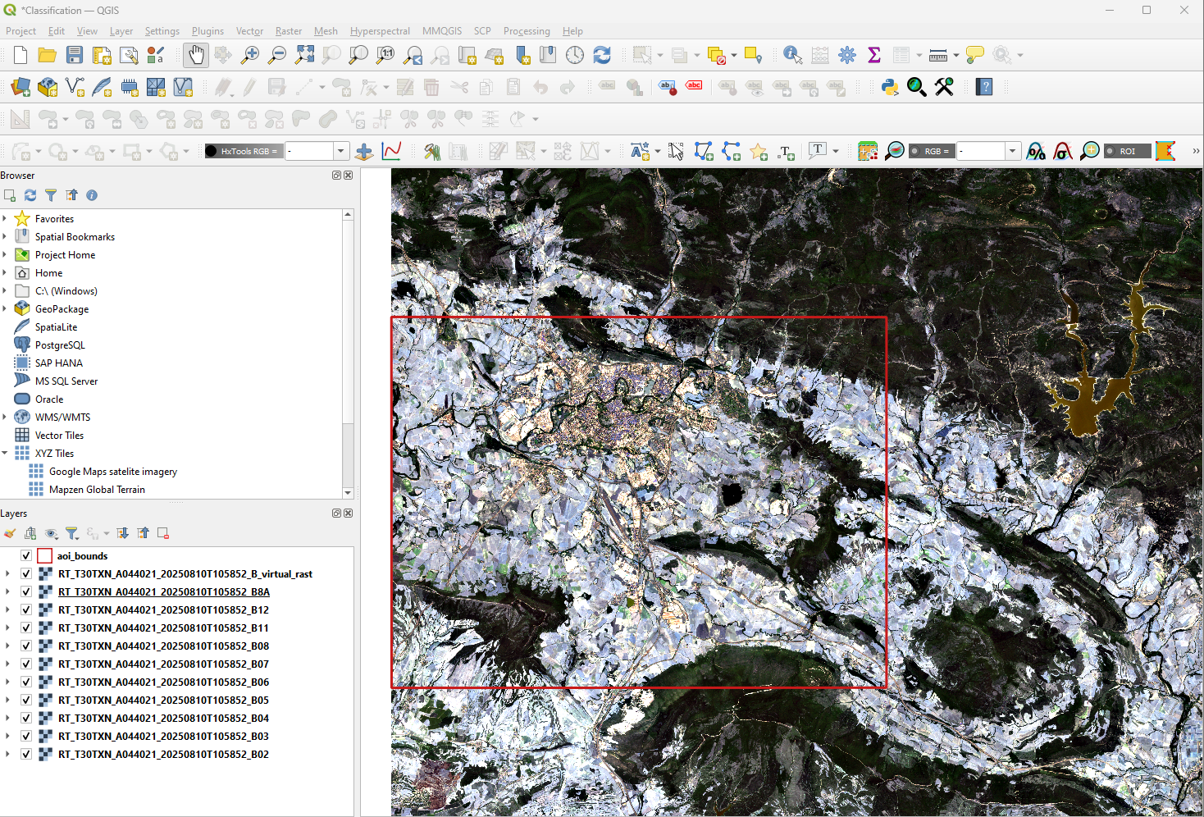
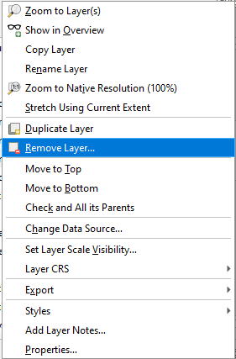
View virtual raster
On your Layers panel, ensure the layer with the suffix _virtual_rast is above all the other rasters.
You may have your bounds layer above as well to see the extent of the area of interest.
TO have a cleaner workspace, remove the layers B02-B12, by right clicking on a layer, and select Remove Layer…
2
3
1

Slide 22
Exploratory analysis

Slide 23
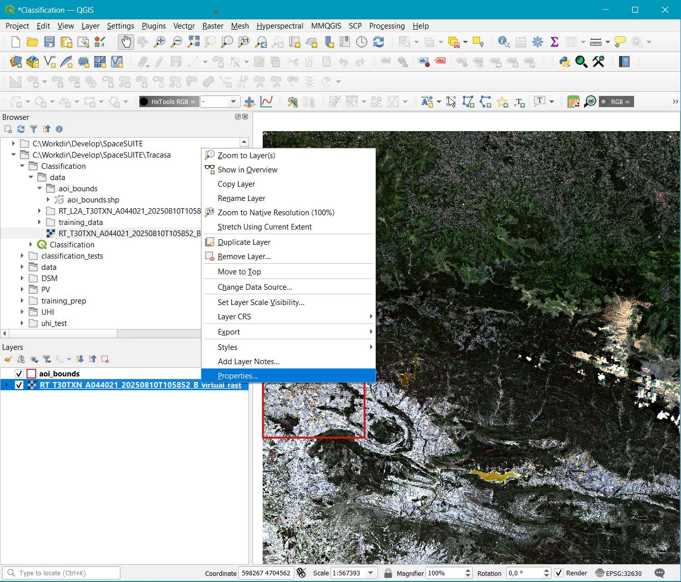
Raster styling
Start with true color raster symbology/ abnd composite, to view objects on the image in R-G-B. At this point, we will not limit our work to the bounding box, but we will retain it. You may toggle it off by unchecking the box if you wish.
To access the symbology window, left-click on your layer in the Layers panel
Right click on Properties…
2
1

Slide 24
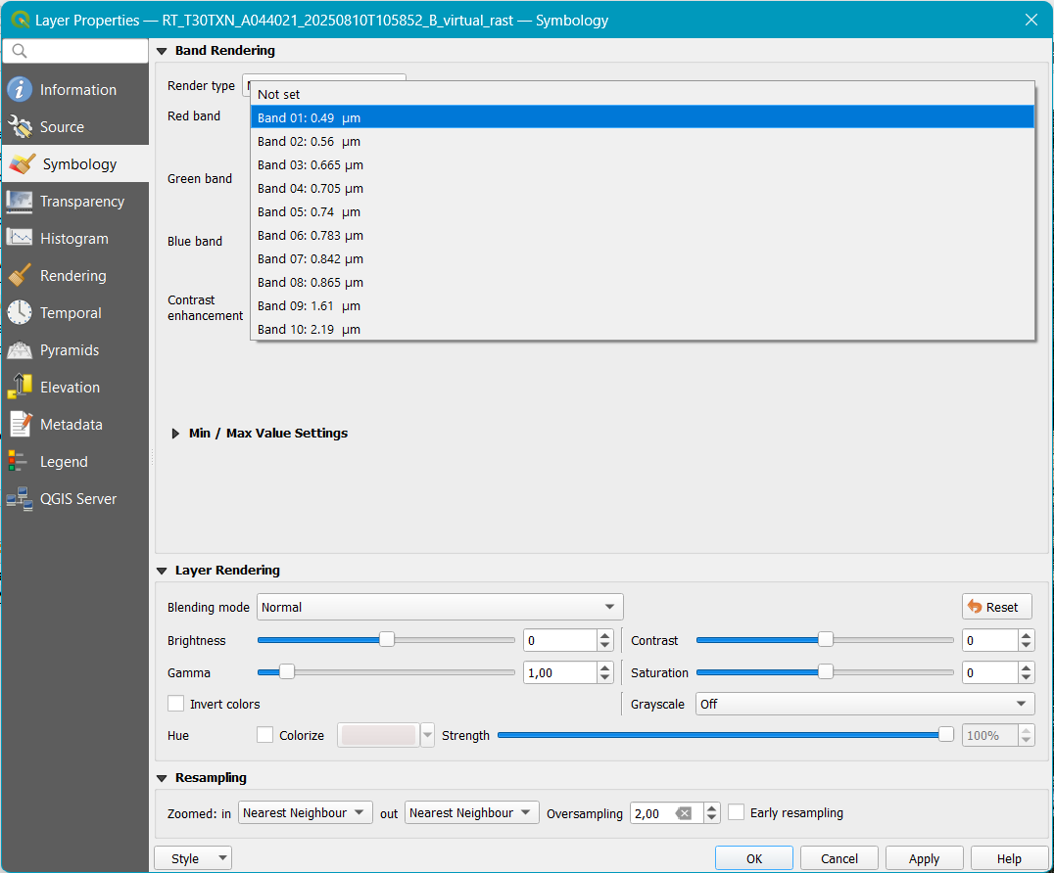
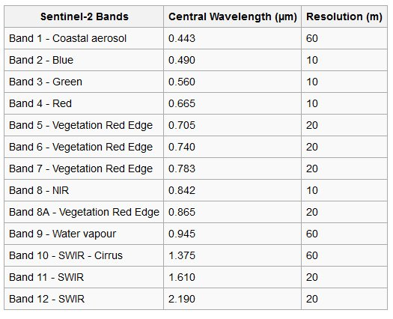
True color image
2
On the left hand pane, click on Symbology
On Render type, stay on the default Multiband color
With the drop-down arrow on Red band, Green band and Blue band, select the correct band from image 4 successively.
This image shows the correct band number and name of a sentinel image.
Once this is in order, click on OK and view your image in the QGIS viewer.
1
3
4
5

Slide 25
Band composites
We use band combinations to better understand the features in imagery. The way we do this is by rearranging the available channels in creative ways.
By using band combinations, we can extract specific information from an image. For example, there are band combinations that highlight geologic, agricultural, or vegetation features in an image.
Exercise: Test out the following band compositions
Color Infrared (B8, B4, B3)
The color infrared band combination is meant to emphasize healthy and unhealthy vegetation
Short-Wave Infrared (B12, B8A, B4)
This composite shows vegetation in various shades of green. In general, darker shades of green indicate denser vegetation. But brown is indicative of bare soil and built-up areas.
Agriculture (B11, B8, B2)
The agriculture band combination uses SWIR-1 (B11), near-infrared (B8), and blue (B2). It’s mostly used to monitor the health of crops.
Geology (B12, B11, B2)
The geology band combination is a neat application for finding geological features using the SWIR-2 (B12), SWIR-1 (B11), and blue (B2) bands. This includes faults, lithology, and geological formations.

Slide 26
Image classification

Slide 27
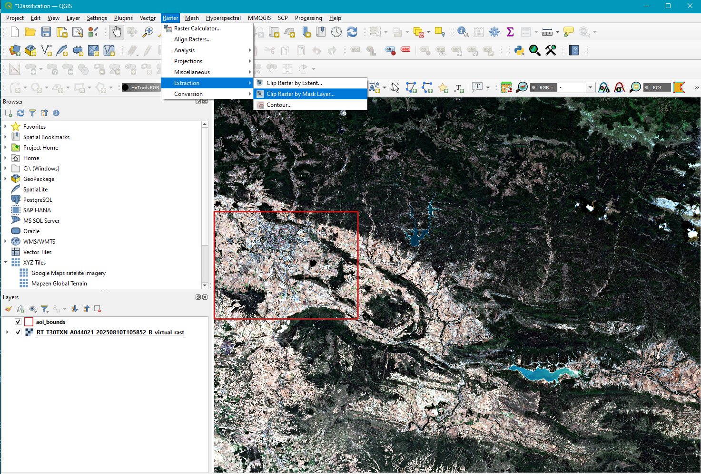
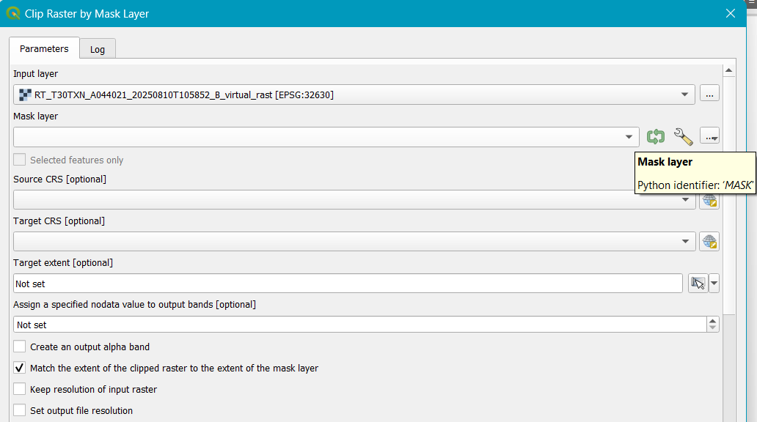
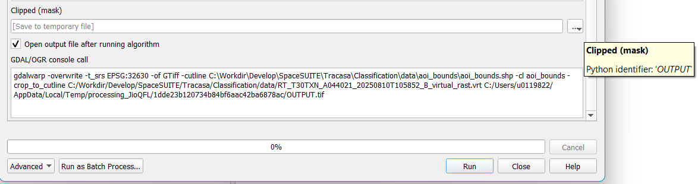
Clip raster
1
Under Raster, select Extraction
Click on Clip Raster by Mask Layer…
On the drop-down arrow, select Input layer(image) and Mask layer(aoi_bounds)
On Target CRS select the Project CRS option
Check the box Match the extent of the clipped raster….
Save your file on the Clipped(mask) by clicking on the … box. Save it in your data folder.
Run the process
2
3
4
5
6
7

Slide 28
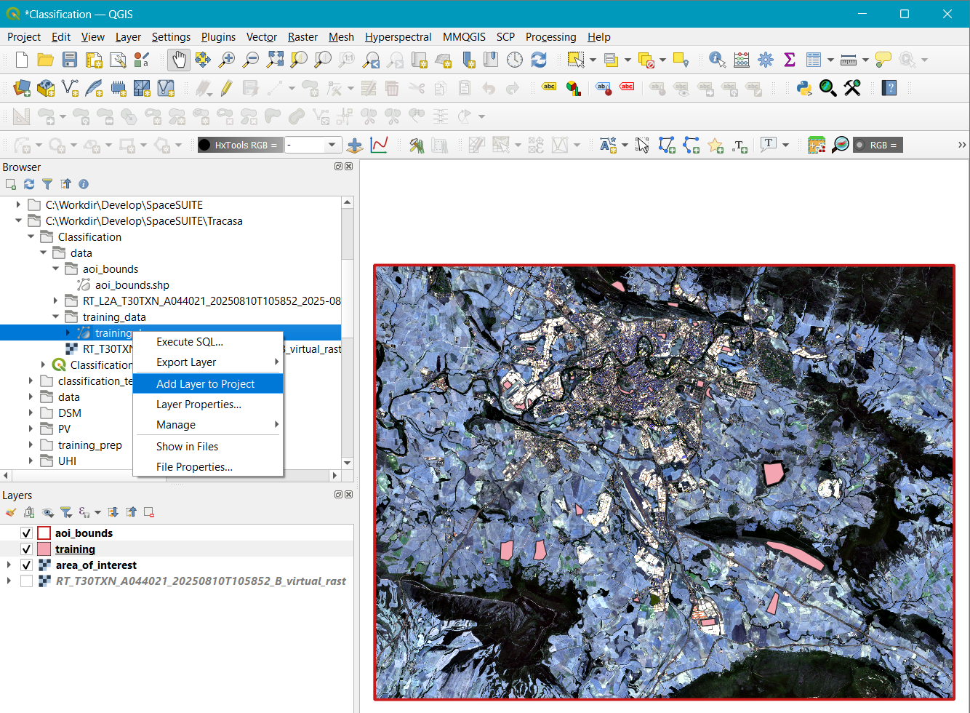
Load training data
5
Load the training polygons to your QGIS project
On Browser, navigate to your Project folder, and find the data folder provided to you.
Click to open the training_data folder
Right click on training.shp, and Add layer to Project
Make sure it is above your clipped area of interest image in the Layers panel.
ALTERNATIVELY, you can add the layer as previously done in the add raster exercise. Using the same process, add your vector layer.
1
2
3
4

Slide 29
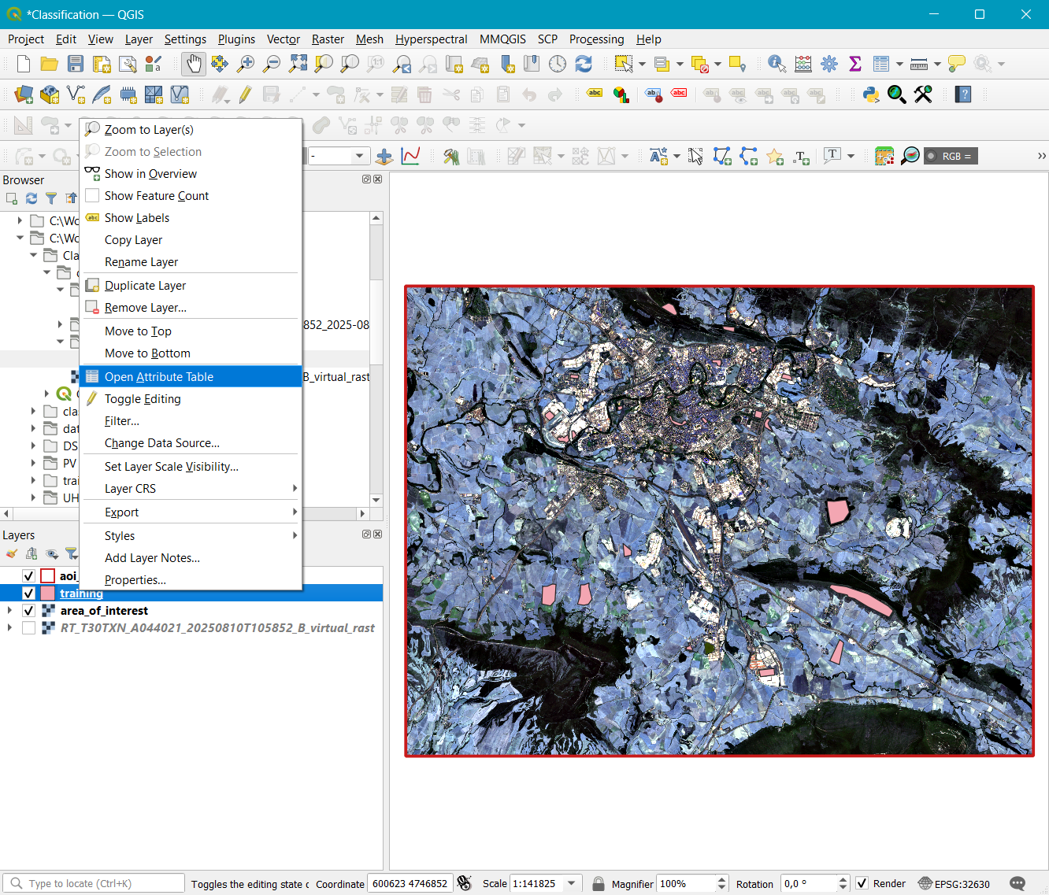
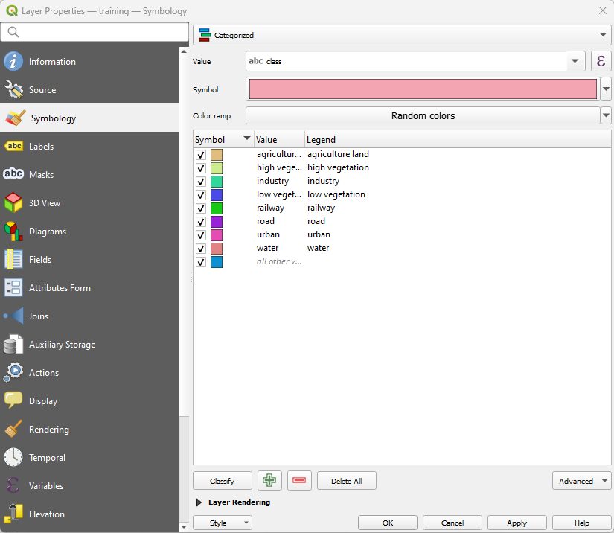
Inspect training data
First left-click on the training layer properties, and on the pop up select Open Attribute Table.
View the table structure, and the training polygon attributes.
To symbolize the vector, open the Symbology window (Properties..-> Symbology).
On the top box, click the drop-down arrow and select Categorized
On Value, select class
Click Classify to classify the polygons by class
Now you can see the different training classes. The default colors can remain.
Click Apply to apply these changes
Click OK to exit.
2
3
1
5
4
7
6

Slide 30
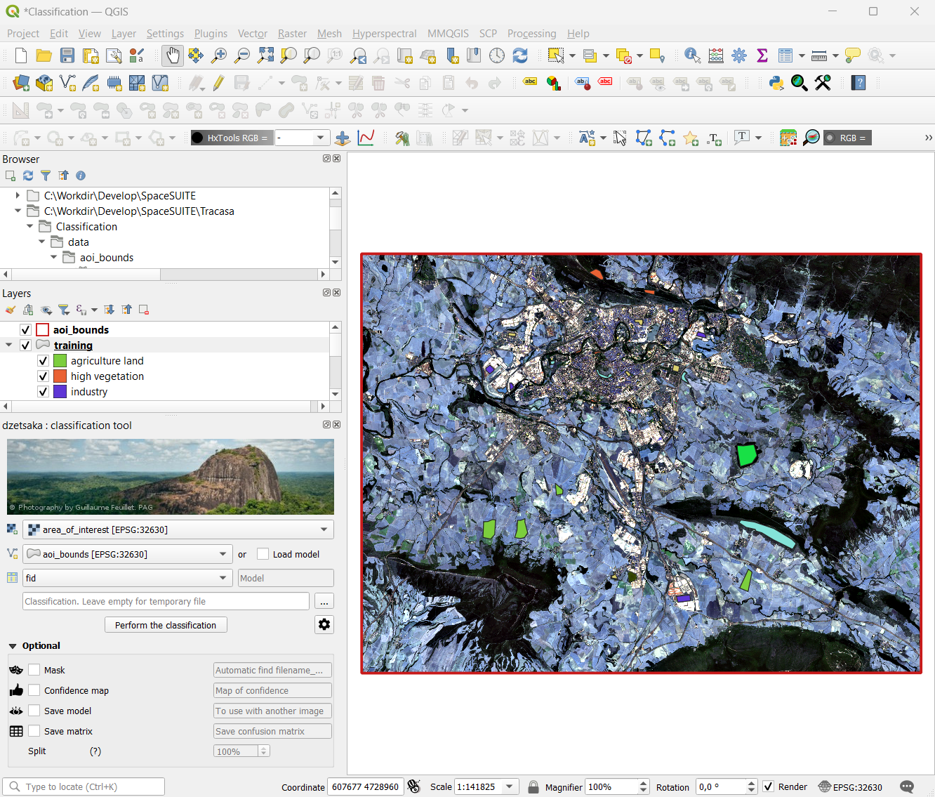
Launch dzetsaka plugin
If you have dzetsaka installed, this icon will appear on the tool bar. Click on it to launch the plugin.
The dzetsaka: classification tool will open, and dock on lower left- or right-hand side of the QGIS window
1
2

Slide 31
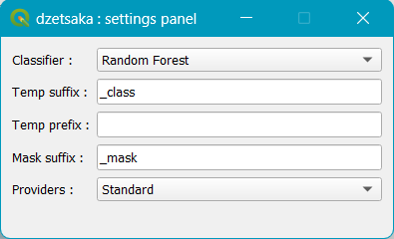
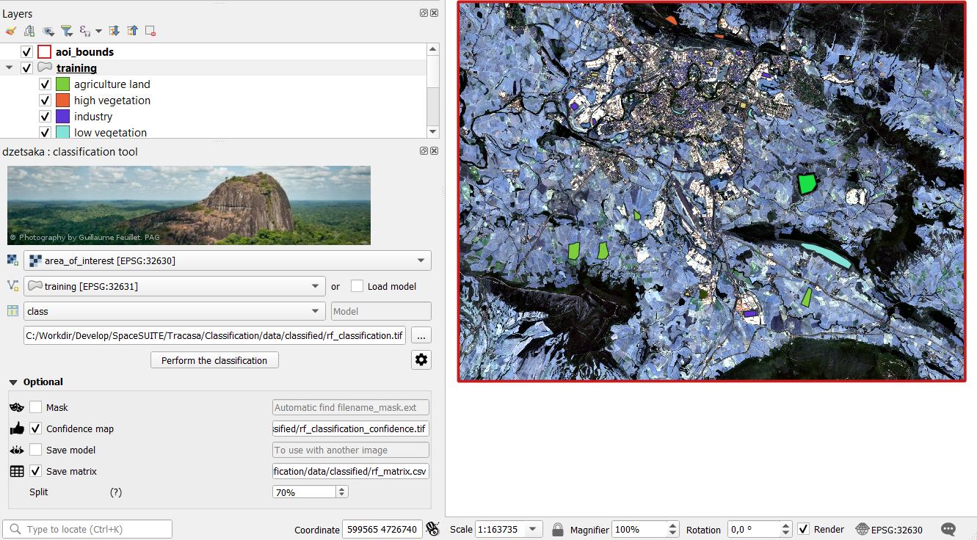
Configure plugin and run classification.
4
Basic settings from the drop-down arrows
Your clipped area of interest raster
Training vector
Select class
Click … and save your future classified image in the classified project folder
Click on the gears icon to select your model.
In the dzetsaka:settings panel that opens, select Classifier - Random Forest. Leave the rest as default
OPTIONAL: Check Confidence map and save it.
OPTIONAL: Check Save matrix and save it
OPTIONAL: Set Split at 70%. (50-75 is fine)
Click on Perform the classification to run the model.
1
2
8
3
5
6
7

Slide 32
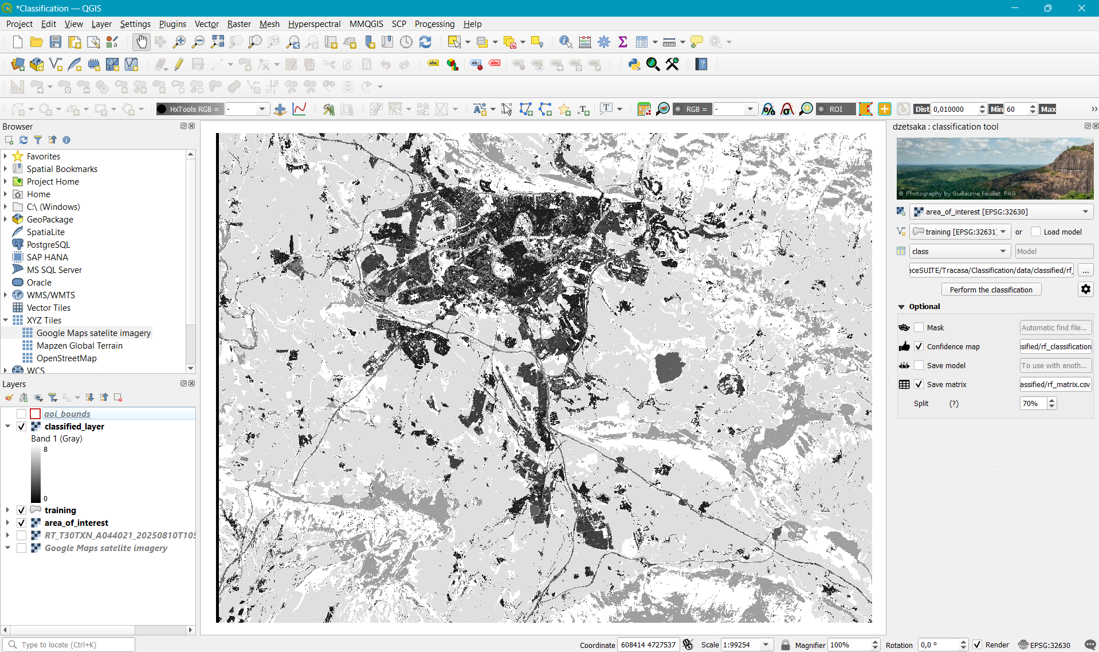
Classified layer
After classification, the classified layer will be automatically be added to the Layers panel.
The classified layer is in Singleband gray. To better view the classification, stylize the layer.

Slide 33
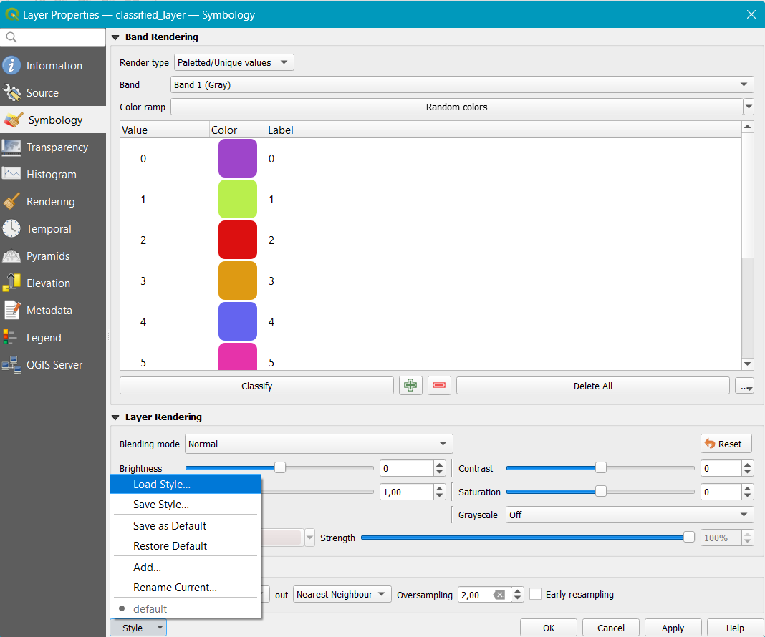
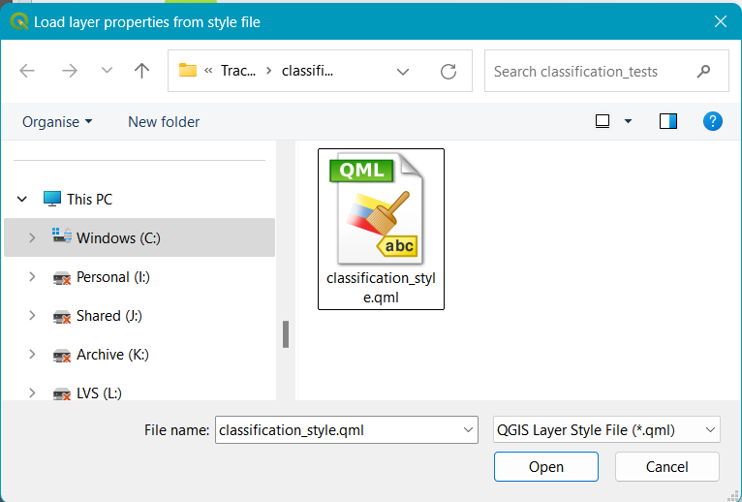
Vector styling
Open Symbology pane
Under Render type, select Paletted/Unique values
Click on Classify to classify into the different classes
Click on Style
Click on Load Style…
In the Load layer properties from style file window, find the classification_style.qml file in the data folder, and click Open to load it.
Click on Apply
Click on OK to close.
1
2
4
5
7
6
3

Slide 34
Post processing
Image classification post-processing refers to the set of steps applied after a model has made predictions on an image. These steps refine the results, eliminating noise by removing/reducing ‘salt and pepper’ effect.
One method is applying a spatial filters, that assigns the most frequently occurring (mode) classification label within a defined spatial neighborhood to each pixel or segment.
Here, we will use the Sieve function available in SCP to post process the image.

Slide 35
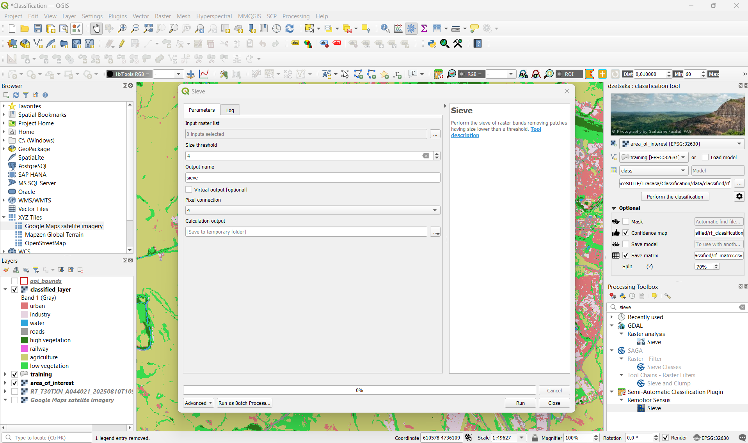
Post processing - Sieve
1
In the menu bar click on Processing and click on Toolbox
Open the Processing Toolbox and type sieve
From the sieve options, select the SCP Sieve
In the Sieve dialogue box, Input your classified raster in the Input raster list
Set Size threshold to 4.
Set Pixel connection to 4
Under Calculation output,(…) save your file to your project folder
Run the process
The sieved image will be added to Layers You will need to perform symbology again as before. If not satisfied, change size threshold and Pixel connections as needed.
4
5
6
7
2
1
3

Slide 36
Accuracy metrics
You can assess the accuracy matrix generated to see the misclassified cells from the matrix csv saved.
Using the confidence map, inspect the low confidence regions and high confidence regions and compare them to the classified map and the high resolution imagery(Google Maps satellite Imagery)

Slide 37
Source
These exercises are prepared using methodologies applied and validated in the Urban Data Spaces for the Green Deal project (USAGE)

